Slide 1


Data Story Telling Case Study
By
Ashitha Swaroop
Rashi Gupta
Rishikesh Patil

Slide 2

Problem Statement
Problem
The revenue of Airbnb has significantly decreased during the last few months.
Now that restrictions have started to loosen, and people have started to travel more.
Airbnb wants to make sure that the company is completely ready for this transformation

Slide 3
Objectives
Understand
Increase revenue by implementing strategies that attract more bookings and drive higher occupancy rates.
Identify
Implement
Identify and analyze the factors contributing to the revenue during the past few months.
Gain a deep understanding of customer preferences and behavior to enhance the user experience and business revenue.

Slide 4
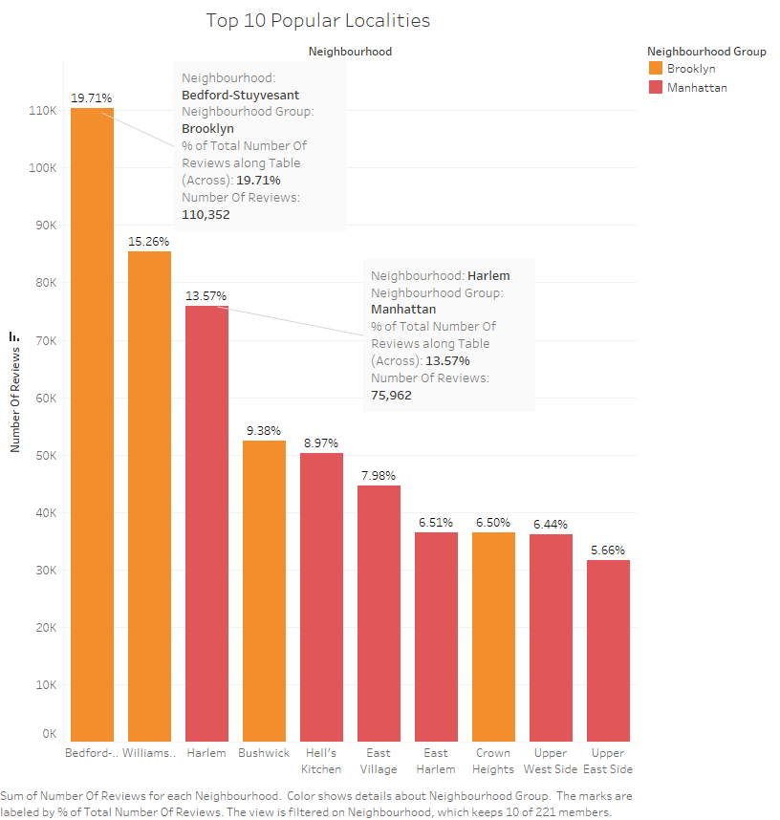
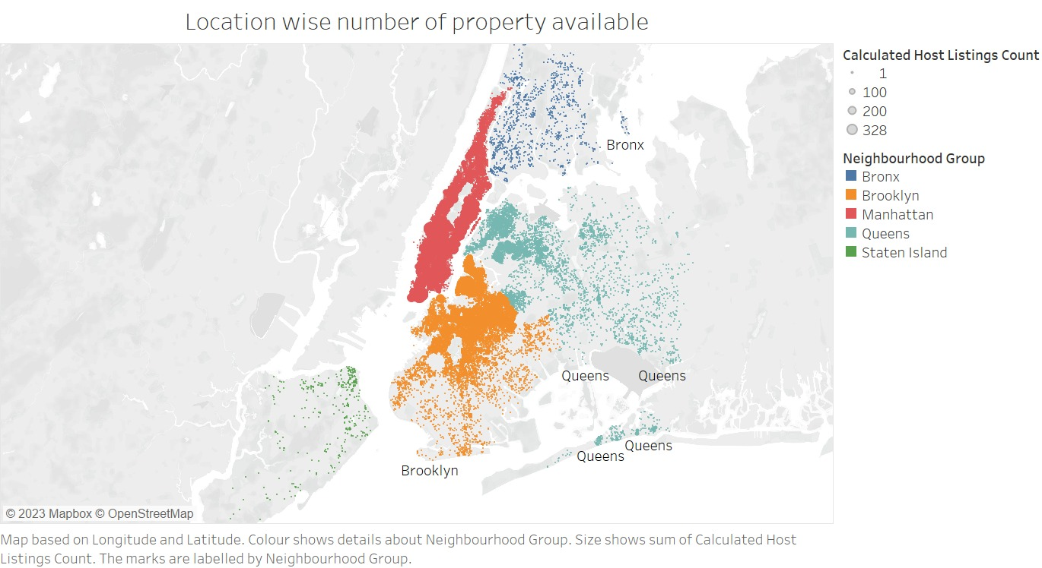
Most Popular Localities in New York
Bedford-Stuyvesant in Brooklyn and Harlem in Manhattan are the most popular localities in New York

Slide 5
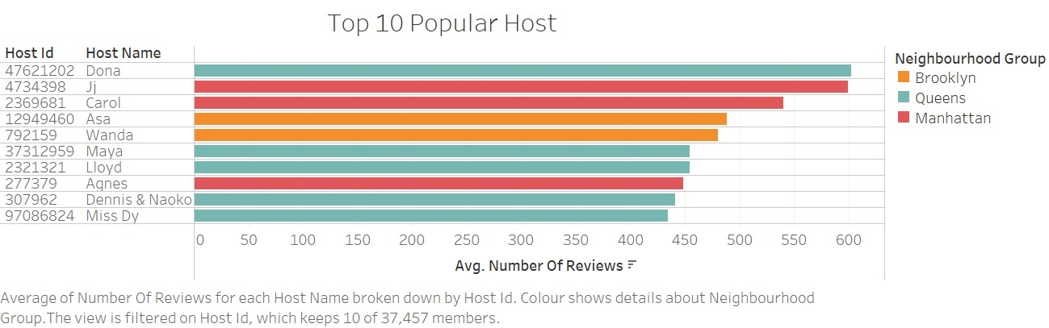
Sought-after top 10 hosts with their respective neighborhood groups.
The majority of hosts in the list are located in Queens.
Among the top hosts, Dona (ID: 47621202), Jj (ID: 4734398), and Carol (ID: 2369681) stand out with the highest number of reviews.

Slide 6
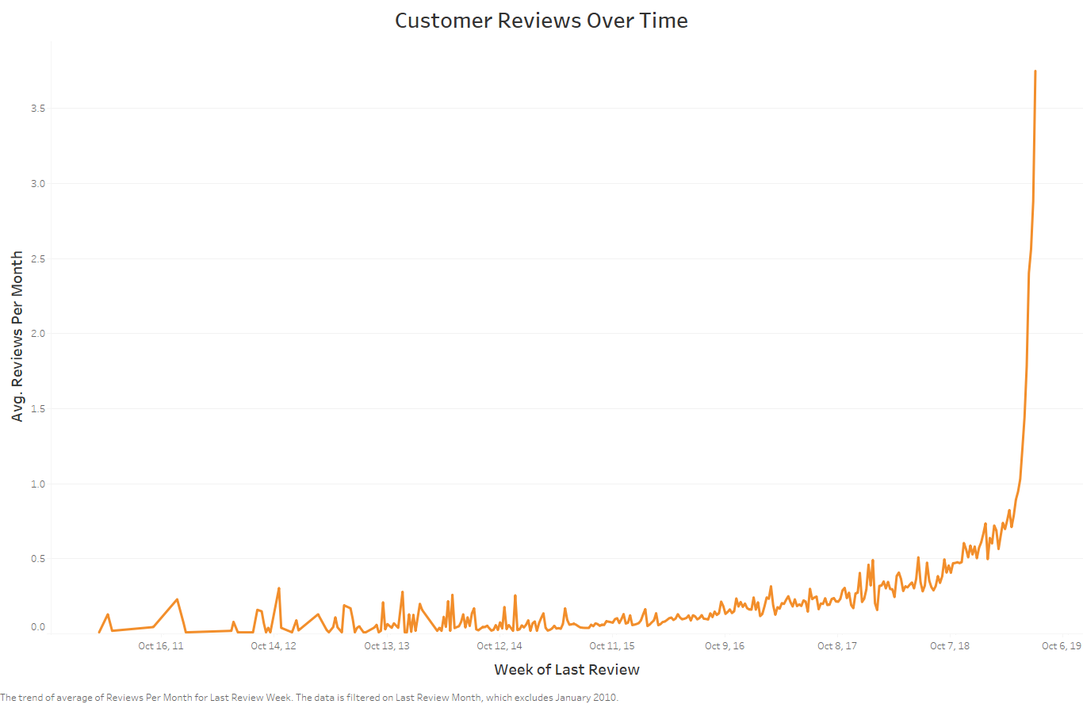
In July 2019, there was a significant increase in reviews across all Neighborhood Groups
Review activity tends to peak during the winter months (December, January, February) and summer months (April, May, June, July).

Slide 7


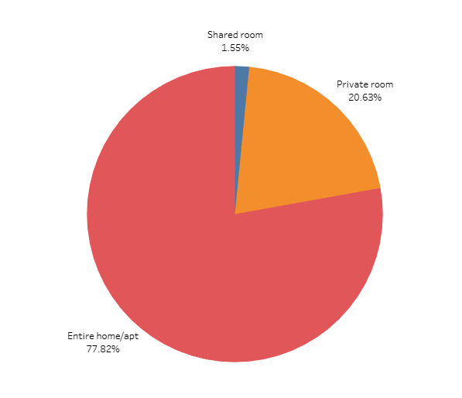
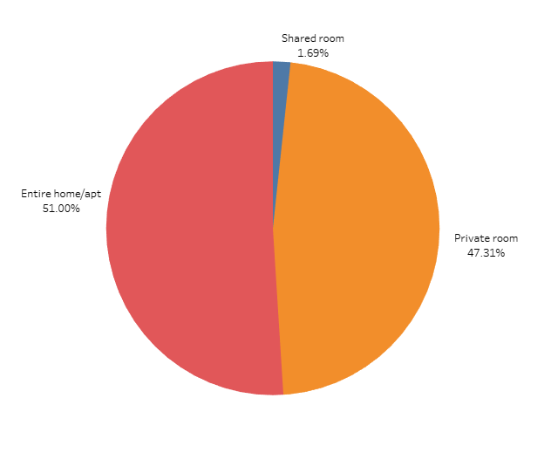
Room Type Based on Popularity and Availability
Room Type Entire Apartments and Private rooms are equally popular
Whereas the availability of entire apartments is more than the private room
Airbnb should focus more on increasing the number of private properties as their popularities is more and availability is less

Slide 8
APPENDIX - DATA SOURCES:
Here is a snapshot of our data dictionary.
Different Airbnb listings along with their hosts, locations, prices, and other attributes.
Properties information such as location, price, reviews, type of Room.
The team used the following data sources:
New York Airbnbs Dataset
Survey conducted in 2019
Notes:
Objective

Slide 9
APPENDIX - DATA METHODOLOGY
We conducted a thorough analysis of the AirBnb Data. The process included:
Cleaning and analysis done using Python.
Analysis done using Excel.
Visual Insight using Tableau.
Notes:
Objective

Slide 10
Assumptions
The number of reviews provided in the dataset is considered a positive measure to analyze customer preferences and satisfaction.
We acknowledge the presence of properties with the existence of outliers. However, for the purpose of our analysis, we assume that these outliers will not significantly impact our findings and conclusions.
Null values present in the dataset are assumed to have no significant impact on the analysis conducted

Slide 11
Suggestions
Airbnb should focus more on increasing the number of private properties as their popularities is more and availability is less
During peak seasons like winters and summers, Airbnb should prioritize acquiring the top 10 hosts who offer both high-priced properties and possess a significant number of listings.
It is recommended to focus on Bedford-Stuyvesant in Brooklyn and Harlem in Manhattan, as these two localities are widely recognized as the most popular areas in New York. Acquiring resources and targeting promotions in these neighborhoods can attract more guests and potentially drive higher bookings.

Slide 12


Thank You
For Your Attention

